Slide 1
Resolving Amazon Inbound or Shipment Defects
Effective strategies for managing shipment and inbound issues
Notes:
AI-generated content may be incorrect. ---

Slide 2
Inbound Defect Resolution Process
Notes:
Identify and Understand Defects, Documentation and Correction, Submission and Monitoring, Amazon Inbound Performance Defect Groups

Slide 3
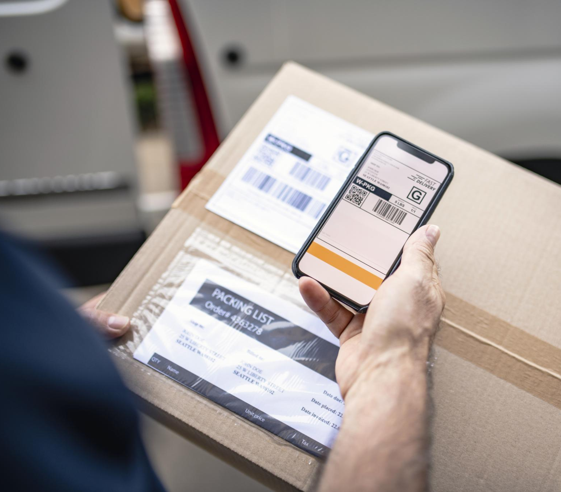
Identify and Understand Defects
Accessing Defect Information
Sellers must navigate to Seller Central's Performance section to find inbound defect notifications and shipment IDs.
Key Defect Details
Each defect report includes defect type, affected SKUs, root cause, and impact on account metrics.
Importance of Understanding Defects
Understanding defect characteristics helps determine corrective actions and ensures fulfillment compliance.
Notes:
To begin resolving inbound or shipment defects on Amazon, sellers must first identify the defect by navigating to Seller Central and accessing the Performance section under Account Health. Within the Inbound Performance tab, sellers can review defect notifications and shipment IDs flagged by Amazon. Each defect includes critical details such as the defect type, affected SKUs, root cause, and its impact on account metrics. Understanding these elements is essential for determining the appropriate corrective action and ensuring compliance with Amazon’s fulfillment standards. This initial step sets the foundation for a successful resolution process by clarifying the nature and scope of the issue.

Slide 4
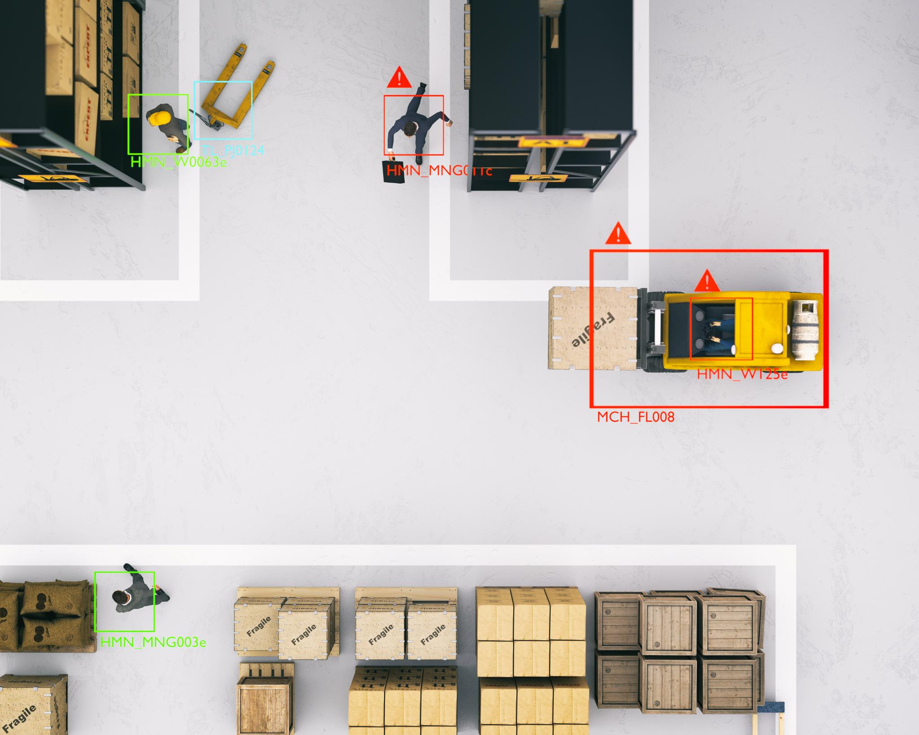
Documentation and Correction
Gathering Necessary Documentation
Collect shipment ID, packing list, packaging photos, and carrier tracking to support defect resolution claims.
Addressing Root Causes
Correct defects by updating labels, adjusting carton size, and ensuring proper preparation compliance.
Preventing Future Defects
Align corrective actions with inbound requirements to prevent future defects and improve shipment quality.
Notes:
Once the defect is identified, the next step involves gathering all necessary documentation. This includes the shipment ID, packing list, photos of packaging and labeling, and carrier tracking details if applicable. These documents serve as evidence to support the resolution claim and help Amazon verify the corrective measures taken. Sellers must then address the root cause of the defect, which may involve updating labeling, adjusting carton dimensions, or ensuring proper prep compliance. Correcting these issues not only resolves the current defect but also helps prevent future occurrences by aligning with Amazon’s inbound requirements.

Slide 5
Submission and Monitoring
Defect Resolution Submission
Sellers submit defect resolutions via Seller Central with shipment ID and detailed corrective actions.
Case Monitoring Process
Sellers monitor case status in the Case Log and receive responses within 3 to 7 business days.
Maintaining Account Health
Clearing defects from the Account Health dashboard helps maintain good standing and avoid penalties.
Notes:
After correcting the defect, sellers must submit the resolution through Seller Central by navigating to Help > Contact Us > FBA Issue and selecting Inbound Performance Defect. The submission should include the shipment ID, a detailed explanation of the corrective action taken, and all supporting documents. Once submitted, sellers can monitor the status of their case in the Case Log. Amazon typically responds within 3 to 7 business days. It is important to ensure that the defect is cleared from the Account Health dashboard to maintain a good standing and avoid potential penalties or disruptions in fulfillment operations.

Slide 6

Amazon Inbound Performance Defect Groups
Labeling Issues
Problems include missing or incorrect FNSKU labels and barcodes that cannot be scanned, affecting inbound processing.
Packaging Problems
Improper box dimensions, weight issues, and non-compliant packaging preparation affect shipment acceptance and handling.
Shipment Accuracy
Errors such as overages, shortages, or incorrect ASINs disrupt inventory accuracy and fulfillment efficiency.
Carrier Compliance & Hazmat Violations
Non-compliant pallet configurations, missing carrier appointments, and hazmat documentation issues lead to delays and safety risks.
Notes:
Amazon categorizes inbound performance defects into several key groups. These include Labeling Issues, such as missing or incorrect FNSKU labels and unscannable barcodes; Packaging Problems, which involve improper box dimensions, weight, or non-compliant prep; Shipment Accuracy, referring to overages, shortages, or incorrect ASINs sent; Carton Content Errors, including missing or incorrect box-level details; Carrier Compliance, which covers non-compliant pallet configurations and missing carrier appointments; and Hazmat/Restricted Product Violations, such as incorrect hazmat documentation or unauthorized restricted items. Understanding these categories helps sellers proactively address and prevent defects, ensuring smoother inbound operations and compliance with Amazon’s standards.

Slide 7

Amazon Inbound Performance Defect Groups
Here’s a comprehensive list of Amazon Inbound Performance defect groups that are tracked in the Shipment Performance dashboard:
📦 Label-Related Defects
- Label missing – product related
- Incorrect label – product related
- Other label problems – product related
- Label missing – box related
📦 Prep-Related Defects
- Unplanned prep – bagging
- Unplanned prep – bubble wrap
- Unplanned prep – product related
📦 Quantity Issues
- Quantity – product related
- Quantity – box related

Slide 8

Amazon Inbound Performance Defect Groups
📦 Safety Issues
- Safety issues – product related
- Safety issues – box related
- Safety issues – pallet related
📦 Product Condition & Listing
- Damaged products
- Expiration problems
- Product listing problems
📦 Restricted or Non-Compliant Items
- FBA restricted items
📦 Transportation & Tracking
- Inaccurate tracking information
- Incorrect tracking information
- Inaccurate transportation weight/dimensions

Slide 9

Amazon Inbound Performance Defect Groups
📦 Other Defects
- Inbound shipment sent to wrong fulfillment center
- Barcode label unscannable
- Barcode label mislabelled
- Barcode label inaccessible
- Barcode label missing
- Suffocation sticker required
- Poly bagging required
- Bubble wrap required
- Taping required
- Opaque bagging required
- Additional units encountered
- Unexpected items found in box
- Unexpected item found in shipment

Slide 10
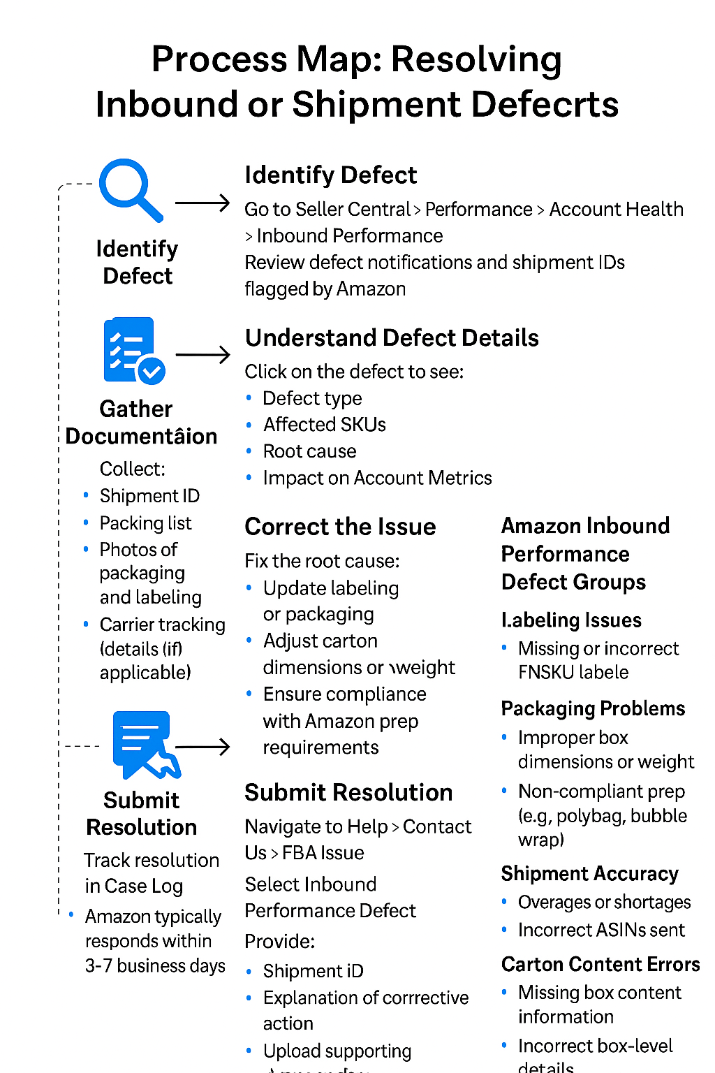
Identify Defect - Go to Seller Central > Performance > Account Health > Inbound Performance - Review defect notifications and shipment IDs flagged by Amazon
Understand Defect Details - Click on the defect to see: - Defect Type - Affected SKUs - Root Cause - Impact on Account Metrics
Gather Documentation - Shipment ID - Packing list - Photos of packaging and labeling - Carrier tracking details (if applicable)
Correct the Issue - Fix labeling, packaging, carton dimensions, or prep compliance
Submit Resolution - Help > Contact Us > FBA Issue - Select Inbound Performance Defect - Provide shipment ID, explanation, and documents
6. Monitor Status - Track resolution in Case Log - Amazon responds in 3-7 business days

Slide 11
